Slide 2
Introduction
Project Objective:
Develop a neural network model to perform sentiment analysis on Amazon product reviews.
The goal is to classify reviews as either positive or negative based on their content.
Importance:
Sentiment analysis helps businesses gauge customer satisfaction and improve products.
It enables automatic categorization of feedback, saving time and resources.
Scope:
Use of a large, pre-labeled dataset from Amazon reviews.
Focus on identifying and classifying positive and negative sentiments.

Slide 3
Rationale Behind the Choice of Project
Data Availability:
The Amazon product reviews dataset is publicly available, rich in data, and contains labeled sentiment data (positive/negative).
This makes it ideal for building a supervised learning model.
Relevance:
Sentiment analysis is an essential application in Natural Language Processing (NLP), used across industries to analyze customer feedback.
Practical Applications:
Companies can use sentiment analysis for product development, customer service, and marketing strategies.
It can also be applied to analyze social media sentiment or to monitor brand reputation.

Slide 4
Ethical Considerations
Data Privacy:
The dataset used contains anonymous reviews, so no personal information is at risk.
Ethical handling of customer data is ensured, and no sensitive information is used.
Bias in Data:
The dataset may contain biases based on the types of products reviewed or the demographics of reviewers.
Careful consideration of these biases is important to ensure fair model predictions.
Fairness in Model:
The model should not favor any particular type of review and should be evaluated for bias in its predictions (e.g., over-predicting positive or negative reviews).
Transparency and Accountability:
The model’s decision-making process should be transparent to stakeholders.
Ensuring model interpretability is crucial for understanding how sentiment predictions are made

Slide 5
Implementation
Data Preprocessing:
Cleaning: Removed punctuation, special characters, and stopwords from the reviews.
Tokenization: Split reviews into individual words.
Padding: Added padding to ensure all input sequences have the same length.
Encoding: Converted reviews into numerical format using token indices. Sentiment labels were encoded as 0 for negative and 1 for positive.

Slide 6
Model Architecture
The Architecture of the model
Embedding Layer: Converts words into dense vectors of fixed size.
LSTM Layer: Captures sequential dependencies in the reviews (good for text data).
Dense Layers: For classification (final decision-making for sentiment).
Activation: Sigmoid activation used for binary classification (positive vs. negative).

Slide 7
Training Process
Split the dataset into 80% training, 10% validation, and 10% test sets.
Used binary cross-entropy loss and Adam optimizer for training.
The model was trained for 10 epochs with batch size of 32.

Slide 8
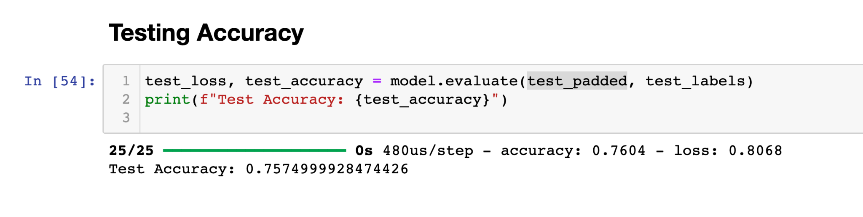
Evaluation & Accuracy
Model Evaluation:
Achieved accuracy of 75% on test data.

Slide 9
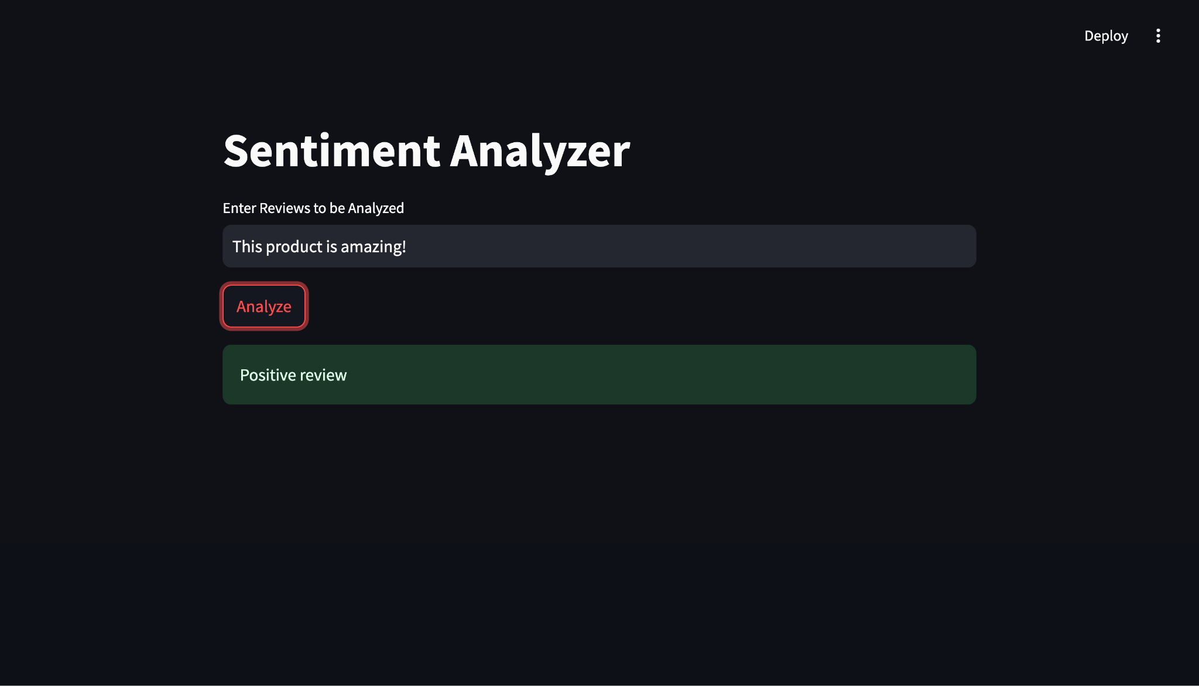
Web Interface

Slide 10
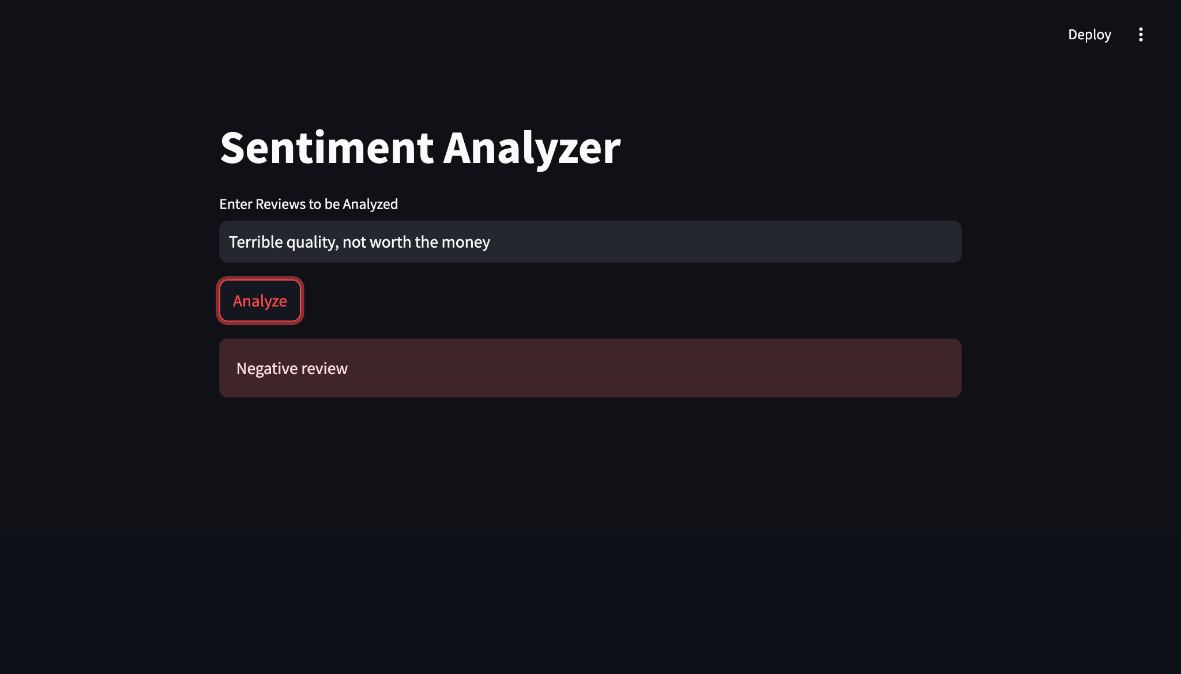
Web Interface

Slide 11
Conclusion and Future Work
Summary:
Developed a sentiment analysis model that classifies Amazon product reviews as positive or negative.
Achieved an accuracy of 85%, with further improvements possible in model tuning and data preprocessing.
Future Improvements:
Address class imbalance: Use techniques like oversampling or synthetic data generation.
More complex models: Experiment with transformer-based models (like BERT) for better performance.
Deploying the model: Create an API or web service to interact with the model in real-time.
Impact:
Improved customer feedback analysis with automated sentiment classification.
Potential to scale the model to analyze sentiment across multiple product categories or platforms.

